Slide 1
Use Internet Explorer only Not Edge /Not Chrome/Not Mozilla

Slide 2
http://aspdashboard.tylertech.com/default.aspx

Slide 3
Choose Database

Slide 4
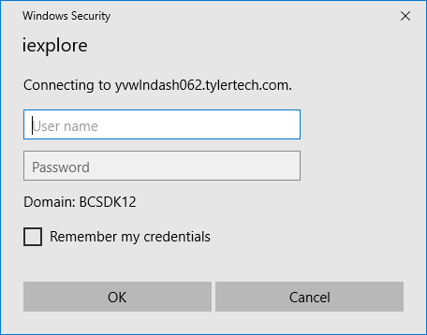
datacenter\6059xxxx password (case sensitive) Windows 7 Windows 10

Slide 5
This your Dashboard.

Slide 6
Dashboard Options
Menu
Web Parts
My Favorites

Slide 7
Tyler Menu

Slide 8
Add to ‘My Favorites’

Slide 9
Web Parts

Slide 10
Personalized Dashboard

Slide 12
Ribbon

Slide 13
Search Area

Slide 14
Confirm Area

Slide 15
Actions Area

Slide 16
Output Area

Slide 17
Office Tools

Slide 18
Menu Area

